Slide 1
Overview of Dataset

Slide 2
Age Distribution
Age
43,885
30
39,981
20
Proportion(%)
22,042
22,929
10
6,462
6,260
30
503
1,677
0
0-14
15-24
25-34
35-44
45-54
55-64
65-74
75-84
85+
Age
Elderly
a
Yes
a
No

Slide 3
Gender Distribution
Gender
72,231(50.2%)
71,555(49.8%)
Female
Male

Slide 4
Ethnicity Distribution
Ethnicity
99,958
60
40
Proportion(%)
20
19,246
18,505
6,077
0
Chinese
Malay
Indian
Others

Slide 5
Marital Status Distribution
Marital Status
90,730
60
40
Proportion(%)
41,390
20
10,193
0
845
628
Single
Married
Devorced
Widowed
Unknown

Slide 6
MediFund Distribution
MediFund
11,234(7.8%)
132,552(92.2%)
Yes
No

Slide 7
Diabetes History Distribution
Diabetes Year
47,609
30
29,594
29,862
20
26,114
Proportion(%)
10
10,607
0
< 1
1 to 2
2 to 5
5 to 10
>10

Slide 8
Patient Type (NHGP/TTSH) Distribution
Patient type
52,469(36.5%)
91,317(63.5%)
NHGP
TTSH

Slide 9
Disease Prevalence Distribution
Disease Prevalence
Dyslipidemia
94.0%
Hypertension
79.9%
CKD
44.2%
SPN
20.2%
CHD
19.7%
Retinopathy
11.6%
Disease
Stroke
11.3%
Asthma
5.4%
Heart Failure
4.5%
COPD
2.0%
Minor Amputation
0.8%
Major Amputation
0.5%
0
25
50
75
100
Prevalence(%)

Slide 10
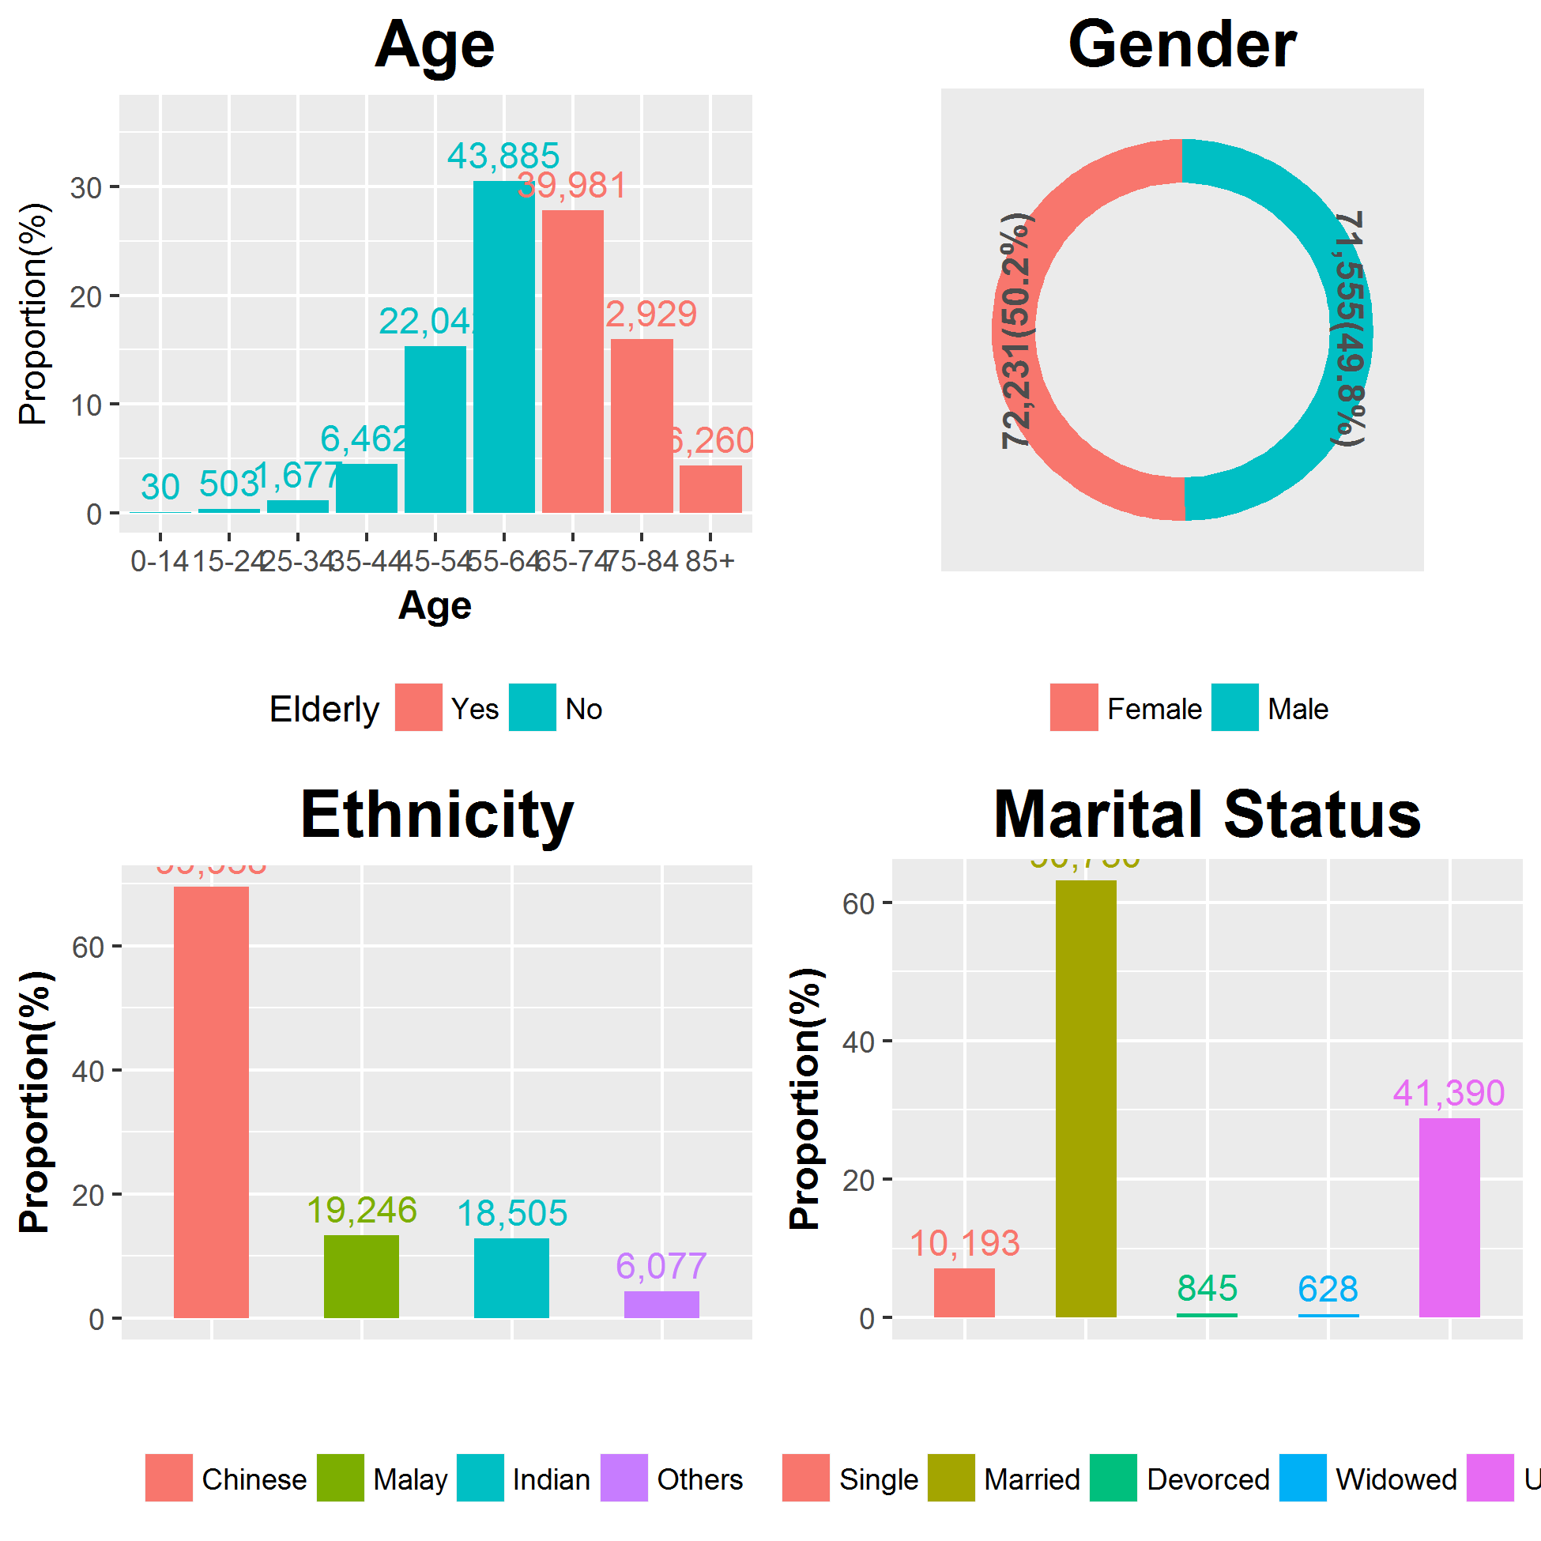
Dashboard - Demographics

Slide 11
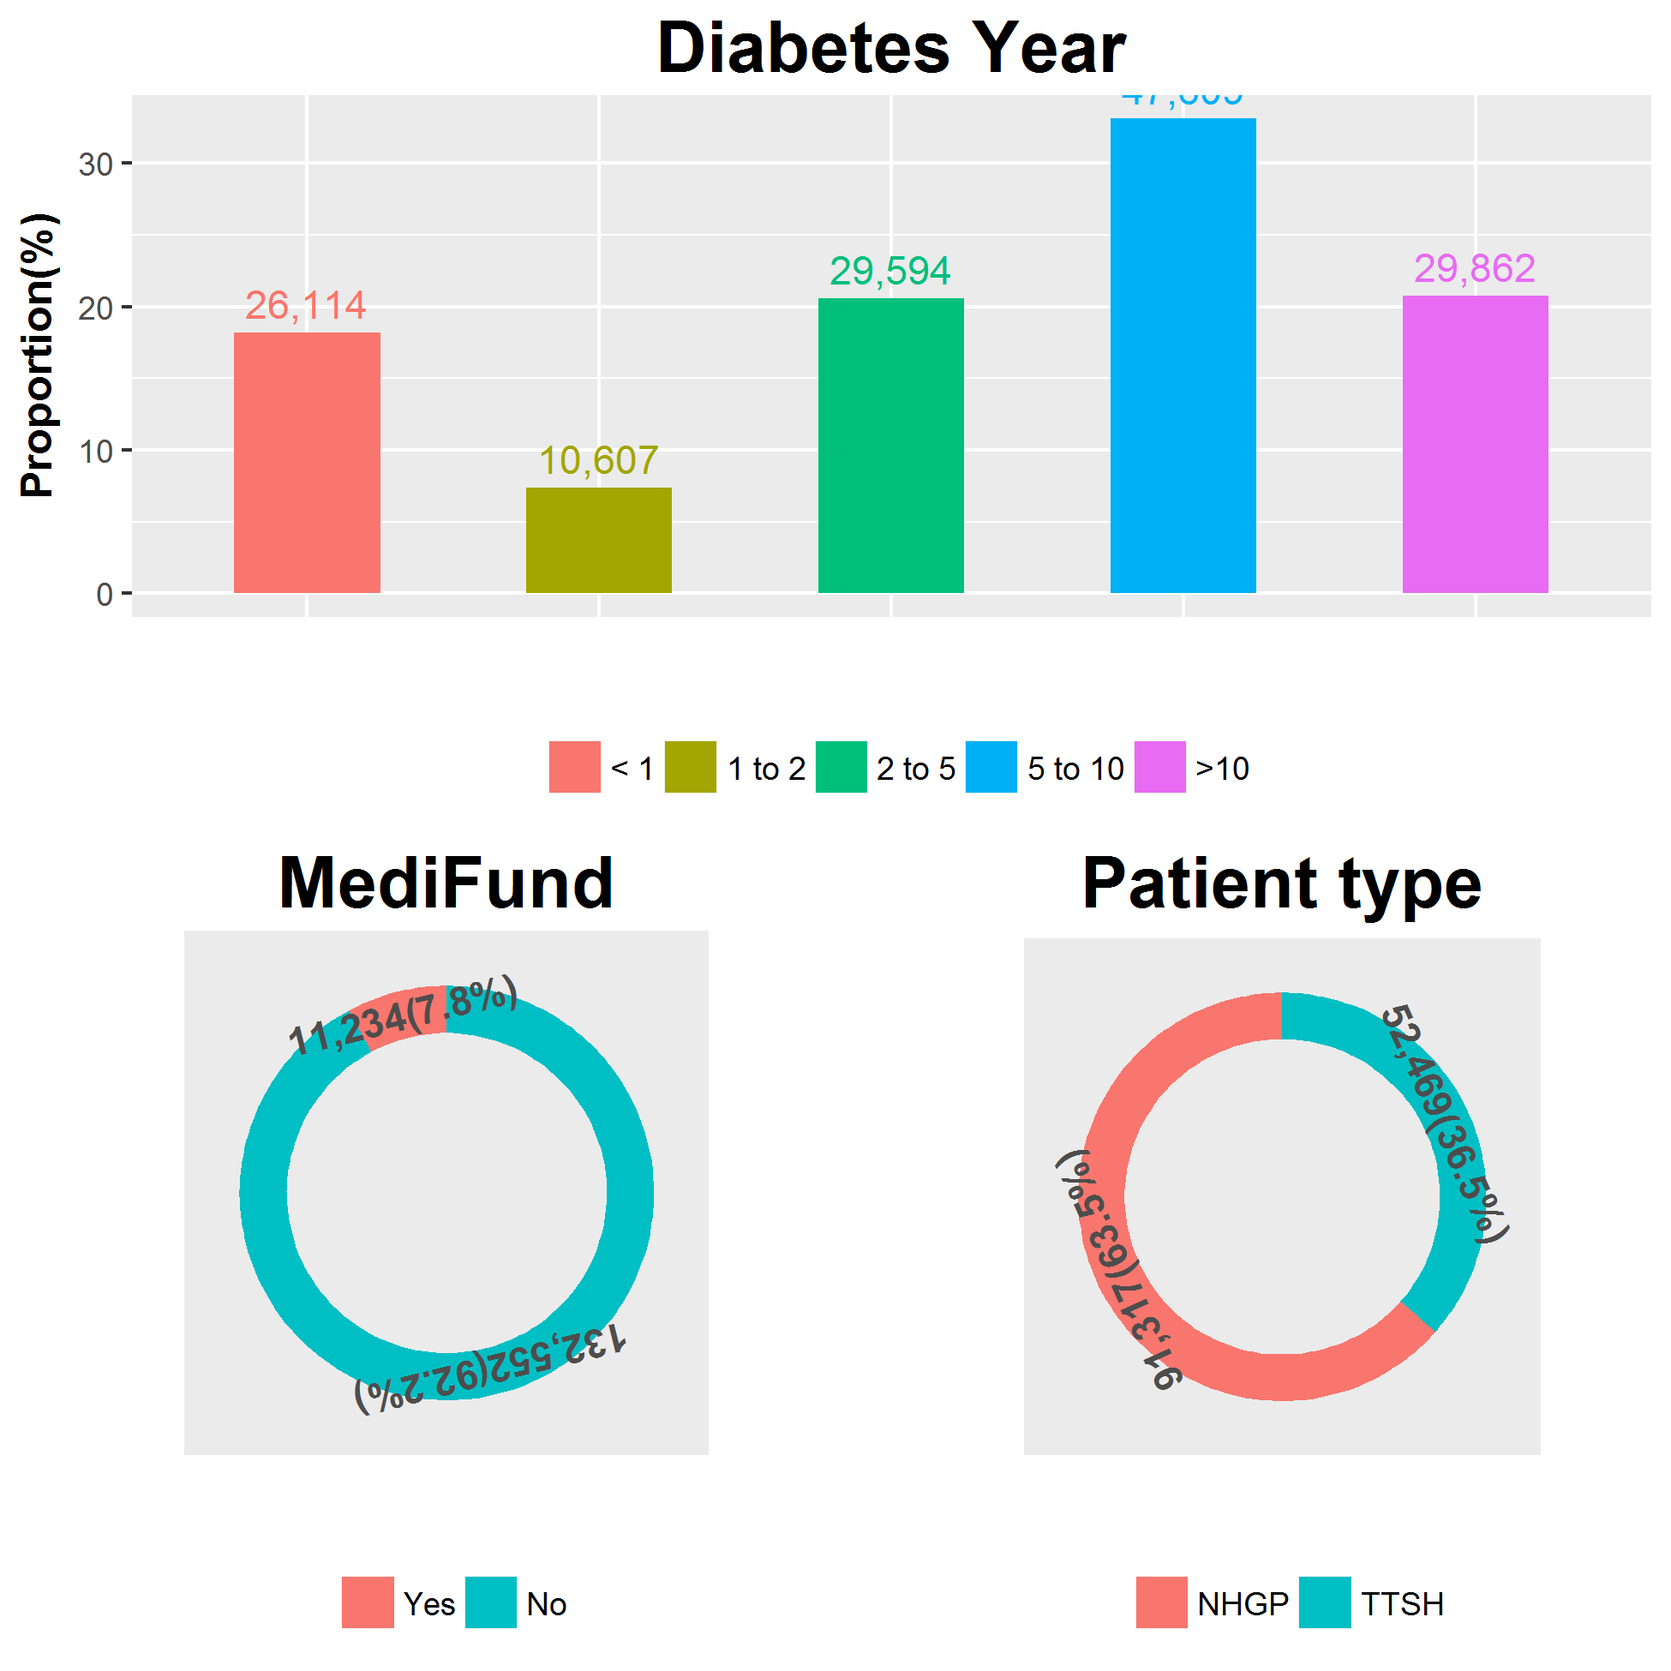
Dashboard - Medical History

Slide 12
Dashboard - Disease Prevalence
Disease Prevalence
Dyslipidemia
94.0%
Hypertension
79.9%
CKD
44.2%
SPN
20.2%
CHD
19.7%
Retinopathy
11.6%
Disease
Stroke
11.3%
Asthma
5.4%
Heart Failure
4.5%
COPD
2.0%
Minor Amputation
0.8%
Major Amputation
0.5%
0
25
50
75
100
Prevalence(%)

